Slide 1
Covid -19 cases in Bangladesh

Slide 2
Presented By-
MD. Thoufiq Zumma : 181-15-10968
Jerin Akther : 181-15-11136
Irin Aktar Pushpa: 181-15-11153
Jannatul Ferdaous : 181-15-11171

Slide 3
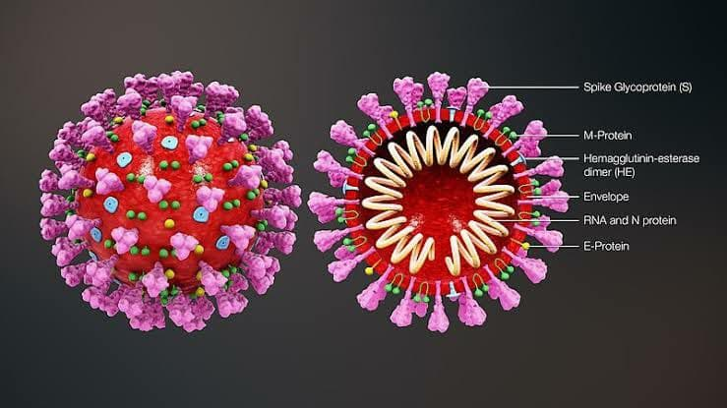
What is CORONA virus?
Coronaviruses are a group of related RNA viruses that cause diseases in mammals and birds.

Slide 4
History of Corona Virus:
Corona virus was previously referred to by its provisional name, 2019 novel coronavirus (2019-nCoV), and has also been called human coronavirus 2019 (HCoV-19 or hCoV-19). First identified in the city of Wuhan, Hubei, China, the World Health Organization declared the outbreak a Public Health Emergency of International Concern on 30 January 2020, and a pandemic on 11 March 2020.
The virus was confirmed to have spread to Bangladesh in March 2020. The first three known cases were reported on 8 March 2020 by the country's epidemiology institute, IEDCR.

Slide 5
Covid-19 Symptoms
Most common symptoms:
-fever
-dry cough
-tiredness
Less common symptoms:
-aches and pains
-sore throat
-diarrhea
conjunctivitis
-headache
-loss of taste or smell
-a rash on skin, or discoloration of fingers or toes
Serious symptoms:
-difficulty breathing or shortness of breath
-chest pain or pressure
-loss of speech or movement

Slide 6
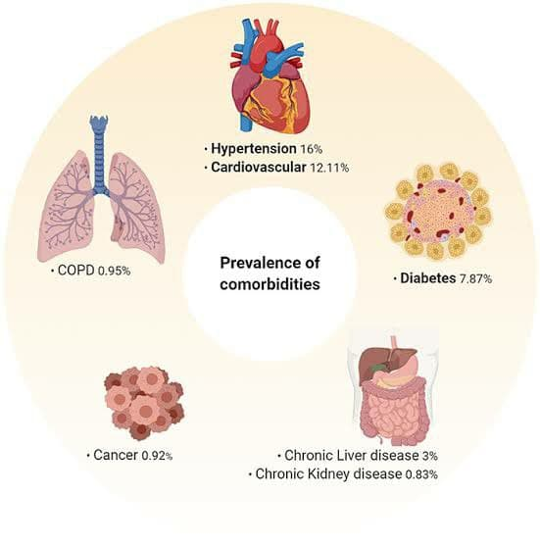
Dysthymia and Risk condition:
Age
HTN
Diabetes
Coronary Heart Disease
Hep B
Cerebrovascular Disease
COPD
Cancer
Children and pregnant women seem to do okay

Slide 7
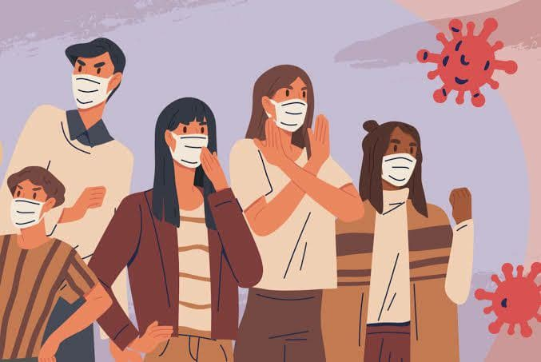
Purpose
To provide an opportunity to evaluate current response concepts, plans and capabilities in response to an outbreak of a novel viral disease.

Slide 8
Planning Consideration:
Timely recognition and isolation
Personal protective equipment use
Protection of healthcare workers, patients, and visitors
Proper reporting to the Tennessee Department of Health
Information management both internal and external
Surveillance, contact tracing, and movement monitoring
Maintaining normal hospital operations
Laboratory services coordination
Environmental and waste management
Patient transportation

Slide 9
Quarantine vs Isolation
Quarantine
Isolation
Stay home for 14 days after your last contact with a person who has COVID-19.
Watch for fever (100.4◦F), cough, shortness of breath, or other symptoms of COVID-19.
If possible, stay away from people you live with, especially people who are at higher risk for getting very sick from COVID-19.
Monitor your symptoms. If you have an emergency warning sign (including trouble breathing), seek emergency medical care immediately.
Stay in a separate room from other household members, if possible.
Use a separate bathroom, if possible.
Avoid contact with other members of the household and pets.
Don’t share personal household items, like cups, towels, and utensils.
Wear a mask when around other people if able.

Slide 10
Vaccination
In Bangladesh, from 3 January 2020 to 6:30pm CEST, 30 July 2021, there have been 1,240,115 confirmed cases of COVID-19 with 20,467 deaths, reported to WHO. As of 9 August 2021, a total of 19,671,620 vaccine doses have been administered.
Bangladesh has administered at least 11,734,447 doses of COVID vaccines so far. Assuming every person needs 2 doses, that’s enough to have vaccinated about 3.6% of the country’s population. 8,018,681 persons vaccinated with at least one dose.
During the last week reported, Bangladesh averaged about 85,962 doses administered each day. At that rate, it will take a further 380 days to administer enough doses for another 10% of the population.

Slide 11
Dataset
COVID Dataset of Bangladesh (division wise)
This COVID cases dataset of Bangladesh is 20th march 2020 to date till 02 July 2021.
Data shape – row 489, column - 37

Slide 12
Components
Python Library:
Numpy
Pandas
Matplotlib
Seaborn
Software: Colab, Jypiter

Slide 13
Data set Description
This CSV file contains Confirmed covid cases, covid case rate, covid deaths, and covid death rate of Barisal, Chattogram, Dhaka, Khulna, Mymensingh, Rajshahi, Rangpur, Sylhet and finally all over Bangladesh. This covid cases dataset of Bangladesh is up to 20th march 2020 date till 02 July 2021. I will try to provide a monthly update. You can use this Bangladesh covid dataset in other words covid dataset for Bangladesh in your covid case in Bangladesh-related projects and covid case in Bangladesh analysis.

Slide 14
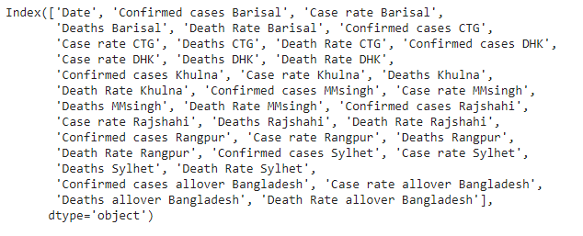
Dataset Columns

Slide 15
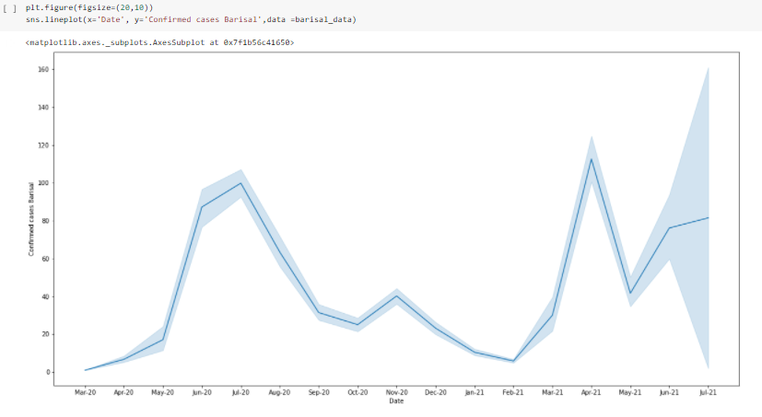
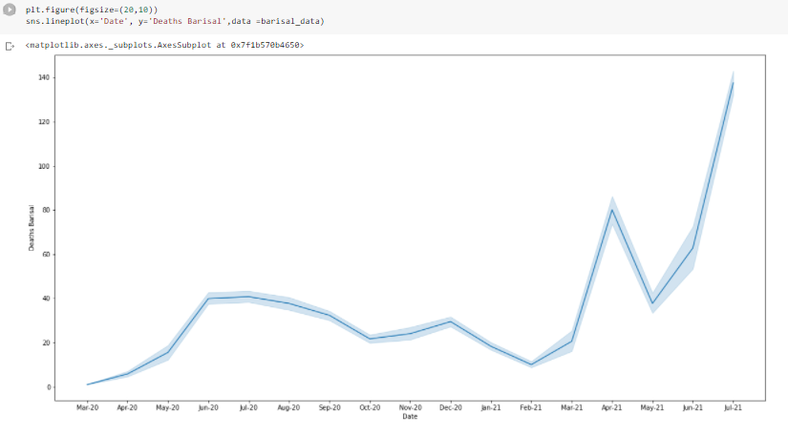
Barisal
Confrimed cases and Deaths

Slide 16
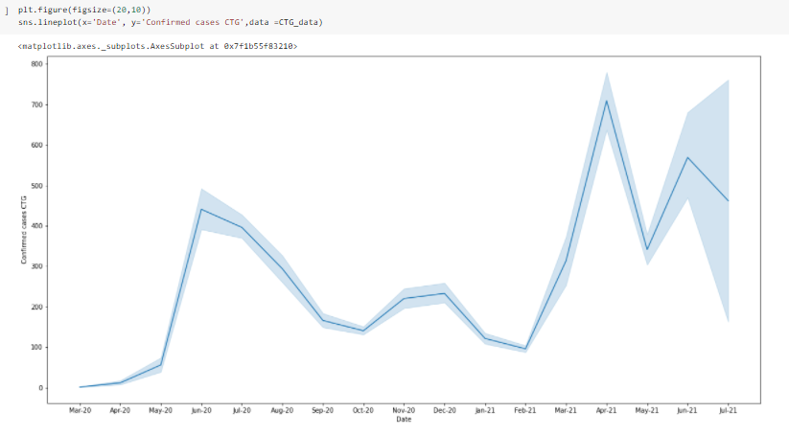
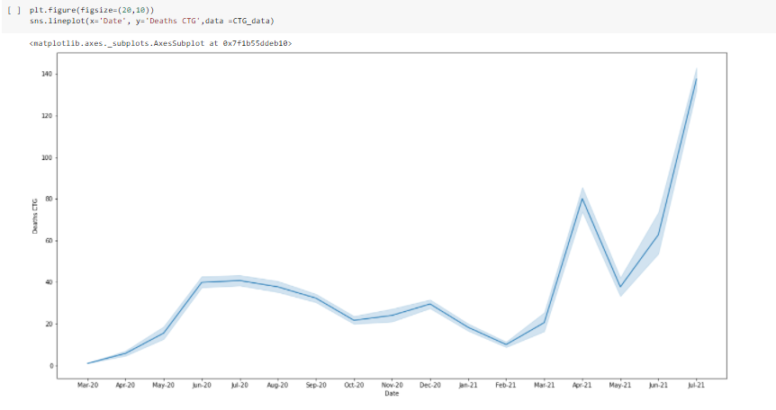
Chittagong
Confrimed cases and Deaths

Slide 17
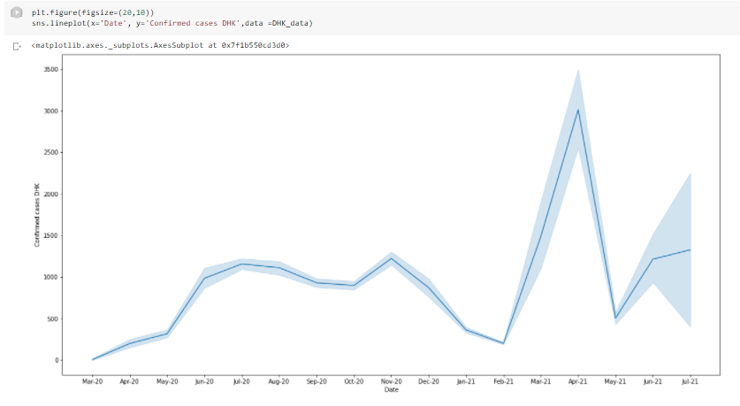
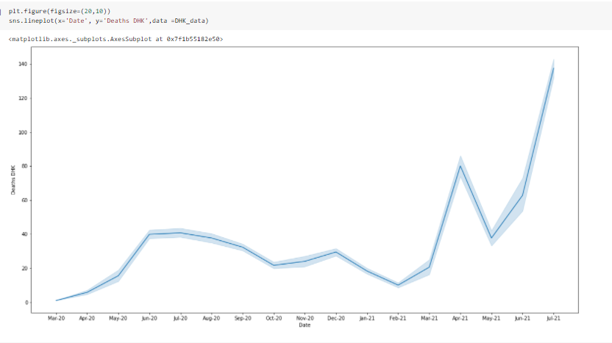
Dhaka
Confrimed cases and Deaths

Slide 18
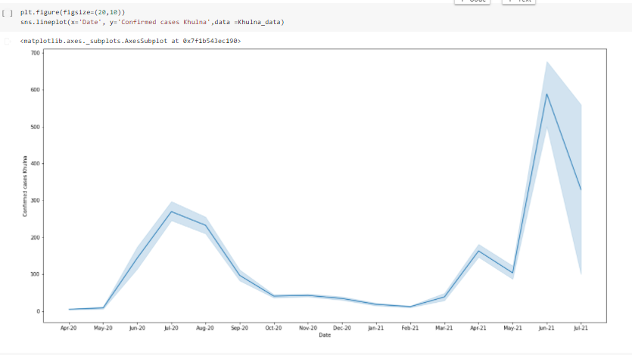
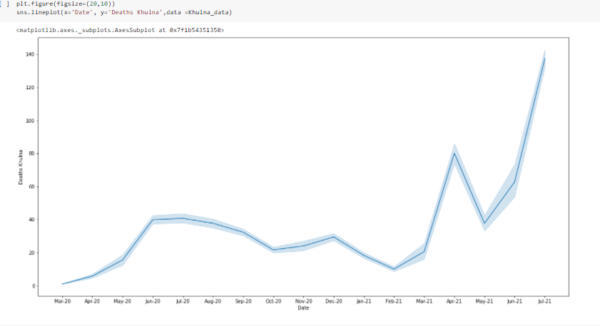
Khulna
Confrimed cases and Deaths

Slide 19
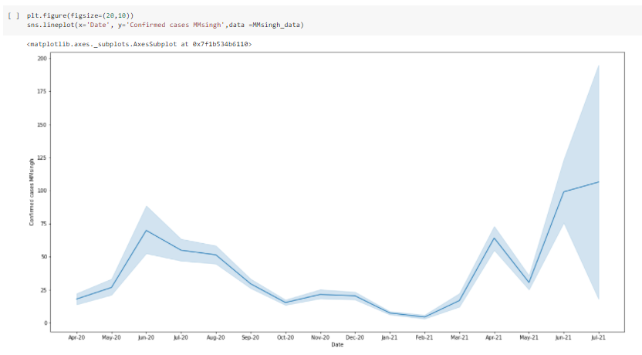
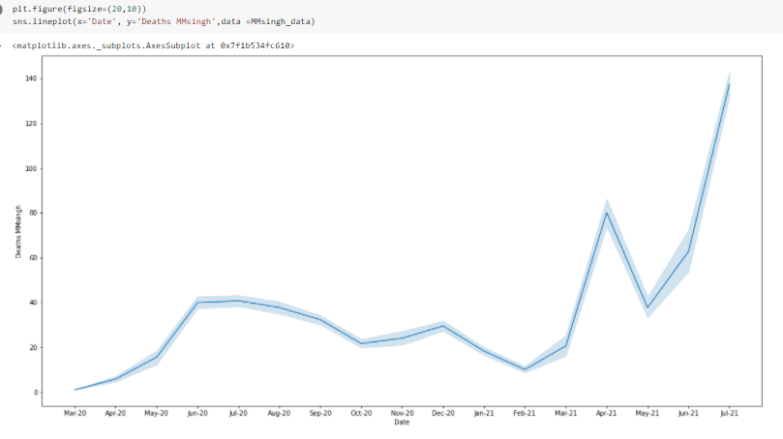
Mymensingh
Confrimed cases and Deaths

Slide 20
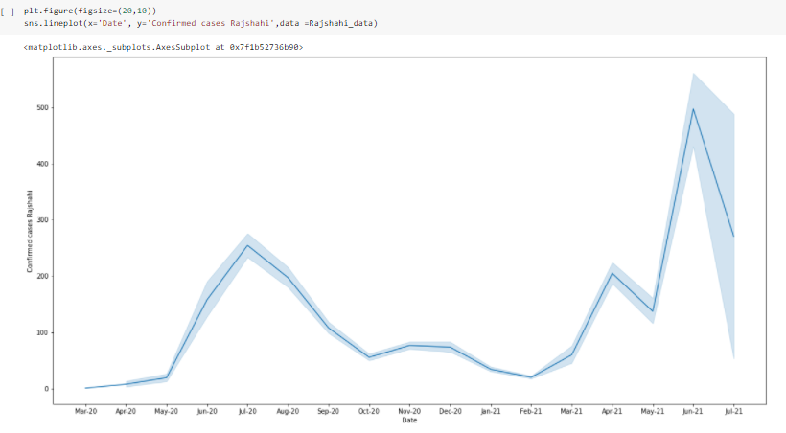
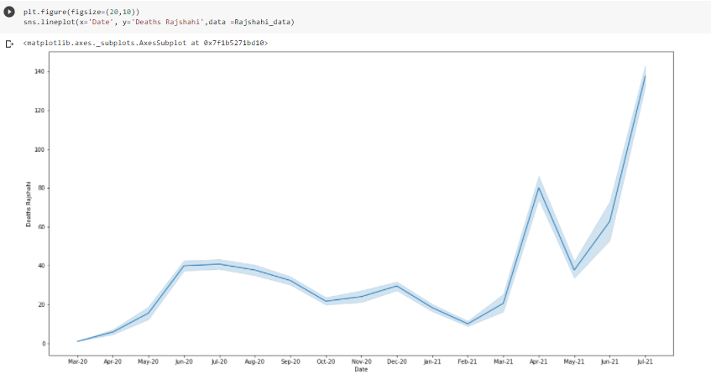
Rajshahi
Confrimed cases and Deaths

Slide 21
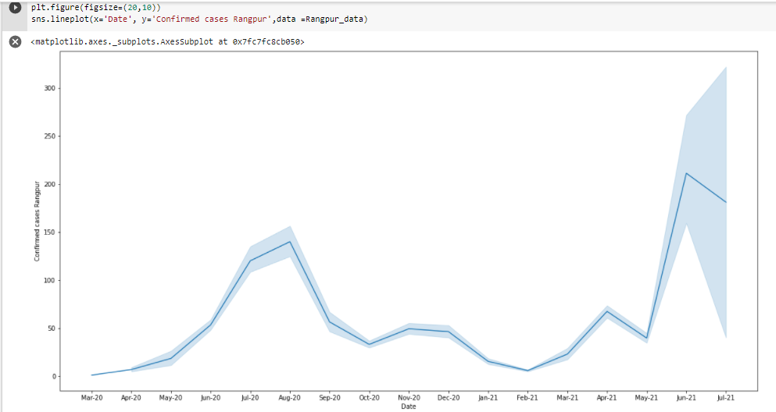
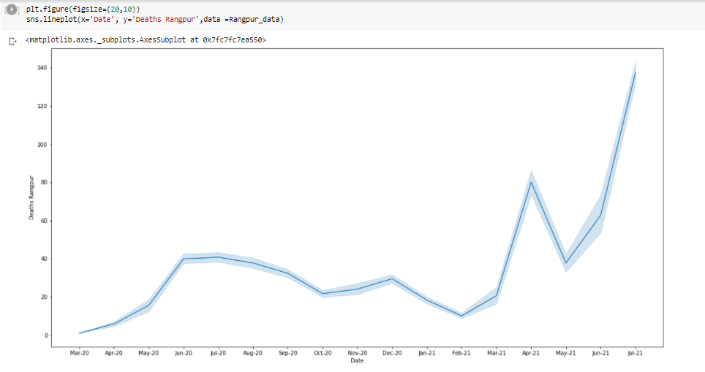
Rangpur
Confrimed cases and Deaths

Slide 22
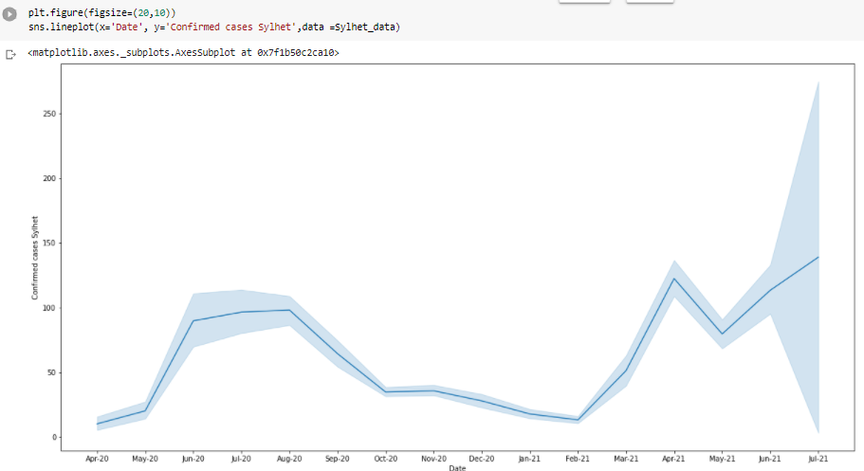
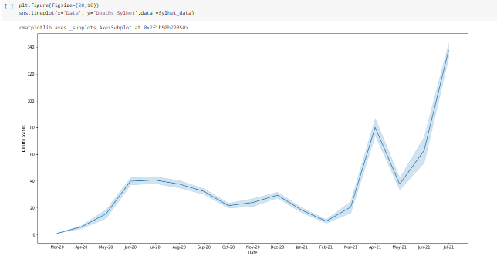
Sylhet
Confrimed cases and Deaths

Slide 23
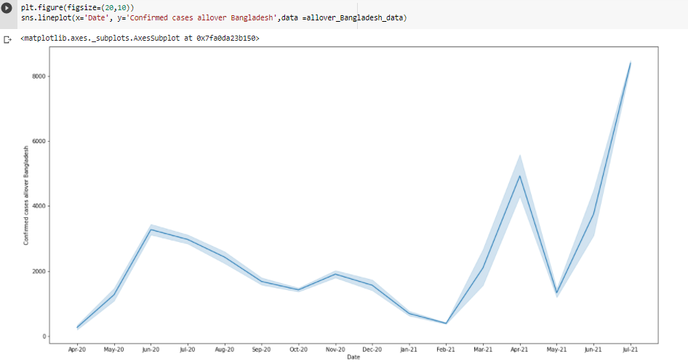
Confirmed cases all over Bangladesh

Slide 24
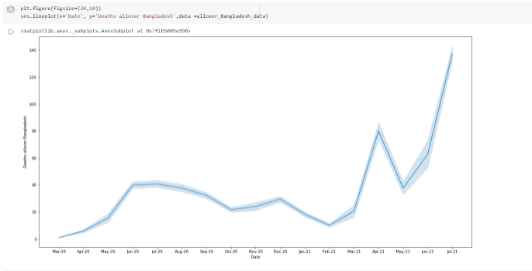
Deaths all over Bangladesh

Slide 25
Coding section

Slide 26
Data on COVID-19 (coronavirus) by Our World in Data
Data shape – row 109972, coloum - 62

Slide 27
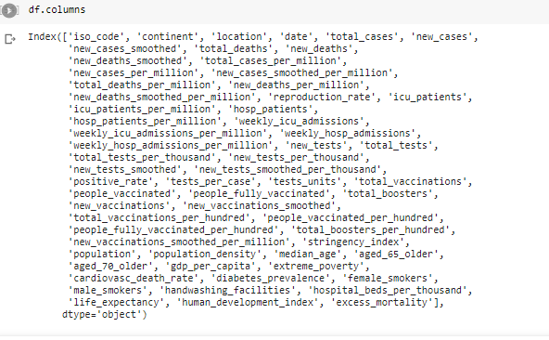
Columns

Slide 28
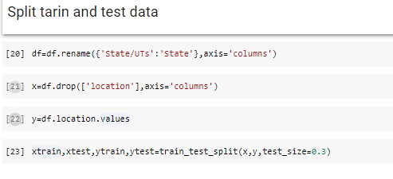
Train test split

Slide 29
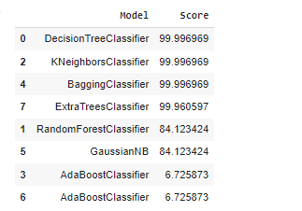
Model score

Slide 30
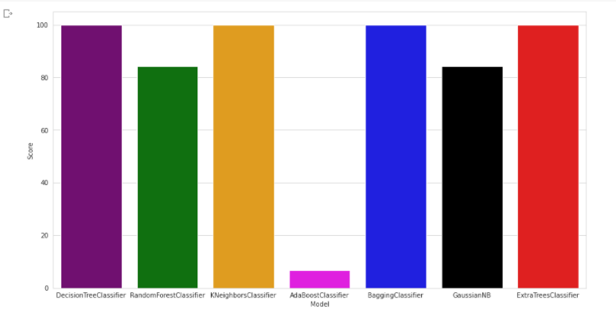
Model score visualization

Slide 31
Coding section

Slide 32
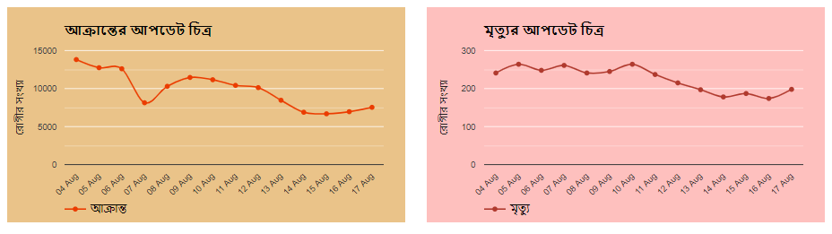
August 2021 latest Update
Reference: https://corona.gov.bd/

Slide 33
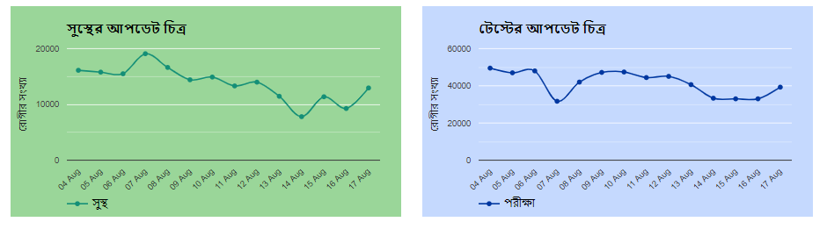
August 2021 latest Update
Reference: https://corona.gov.bd/

Slide 34
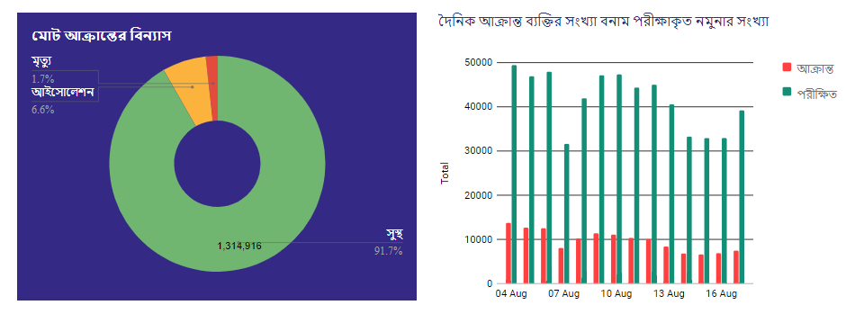
August 2021 latest Update
Reference: https://corona.gov.bd/

Slide 35
Project Outcome:
In this project, We wanted to show a proper idea about all the divisions of Bangladesh during the Covid pandemic by the visualization. So that it is very easy to know about Bangladesh in the pandemic time. And we have used data mining on all the Covid data sets in the world. Which are collected by Our World in data. If anyone watches our project, they will be clear about our country's death rate, Confirm cases rates easily. And we added world COVID data, it will help to artificial intelligent sector.

Slide 36
Source Code
Github link :
https://github.com/thoufiqzumma/Covid-19-cases-in-Bangladesh-divisionwise-

Slide 37


